Slide 1

Phishing Awareness Training
Recognizing and Preventing Phishing Attacks
Meryem farhat
CA/JA3/3916

Slide 2
Table of contents
01
03
05
02
04
How Phishing Works
How to Spot a Phishing Email
Introduction
Types of Phishing Attacks
Real-Life Examples

Slide 3
Table of contents
07
09
08
What to Do If You Get Phished?
How to Stay Safe
Conclusion

Slide 4
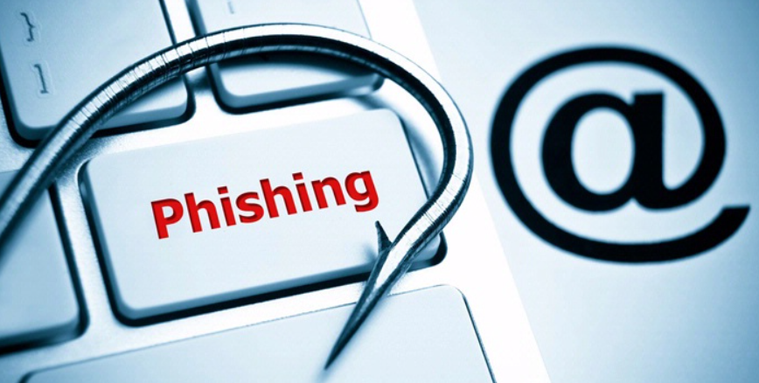
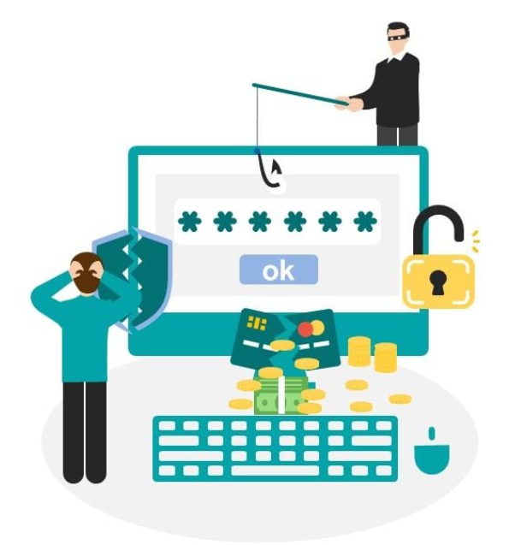
Introduction
What is Phishing?
A cyber-attack where attackers trick people into giving sensitive information.
Often done through emails, fake websites, or messages.
Why is it Important?
Protects individuals and companies from fraud, identity theft, and financial loss.

Slide 5
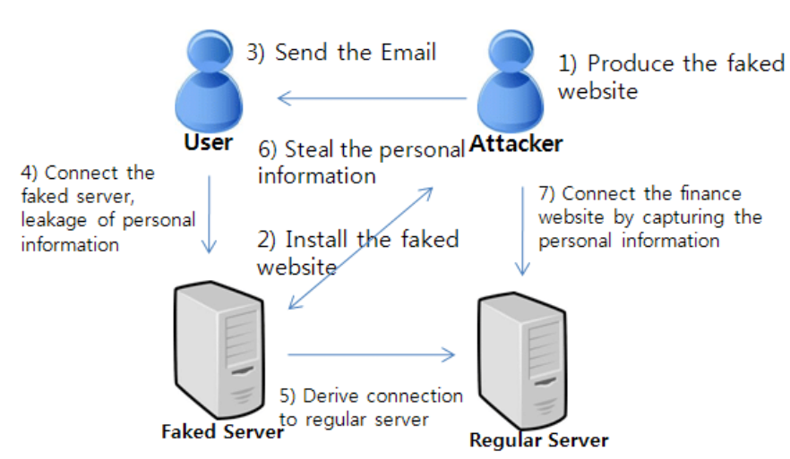
How Phishing Works
Common Methods:
Fake emails from trusted sources
Fake login pages
Urgent messages (e.g., "Your account will be locked!")

Slide 6
Types of Phishing Attacks
Email Phishing:
Fake emails pretending to be from banks, companies, etc.
Spear Phishing
Targeted attacks on specific individuals or organizations.
Smishing & Vishing :
Phishing via SMS and voice calls.
Whaling :
Attacks on high-profile individuals (CEOs, executives).

Slide 7
How to Spot a Phishing Email
Suspicious Links
Spelling Errors
Unknown Senders
Fear Tactics
Hover over the link before clicking.
Many phishing emails have grammar mistakes.
Be cautious with unexpected emails.
"Your account has been compromised! Reset your password immediately!"

Slide 8
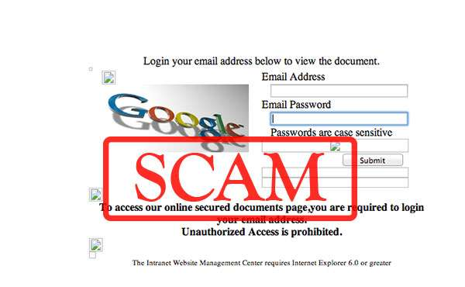
Real-Life Examples
1️ Google Docs Phishing Attack (2017)
📌 What Happened?
-Attackers sent fake Google Docs sharing invitations to millions of users.
-Clicking the link led to a fake login page, where victims entered their credentials.
-The attacker gained access to emails and sensitive data.

Slide 9
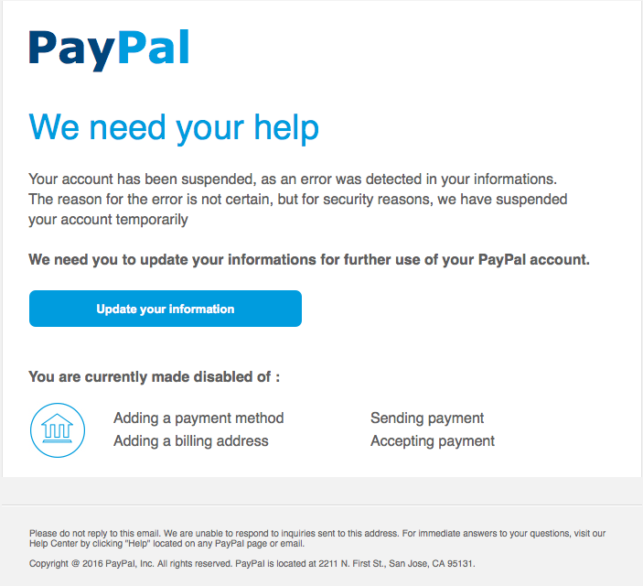
Real-Life Examples
2️ PayPal Phishing Scam
📌 What Happens?
-Users receive an email claiming "Your PayPal account is suspended!"
-The email includes a link to a fake PayPal website that asks for login details.
-Attackers steal login credentials and banking details.

Slide 10
How to Stay Safe
1st
2nd
3rd
4th
Verify Links & Senders before clicking.
Use Strong & Unique Passwords.
Enable Multi-Factor Authentication (MFA).
Report Phishing Emails to IT/security teams.

Slide 11
What to Do If You Get Phished?
Monitor Your Accounts for suspicious activity.
Change Passwords Immediately.
Report the Incident to security teams.
Stay calm and avoid clicking any further links or providing more information.

Slide 12
Conclusion
Phishing remains one of the most common yet preventable cybersecurity threats. By staying vigilant and verifying emails, links, and requests for sensitive information, individuals can significantly reduce their risk of falling victim to such attacks. Awareness and education are key—staying informed and cautious not only protects personal data but also strengthens the security of organizations as a whole.

Slide 13
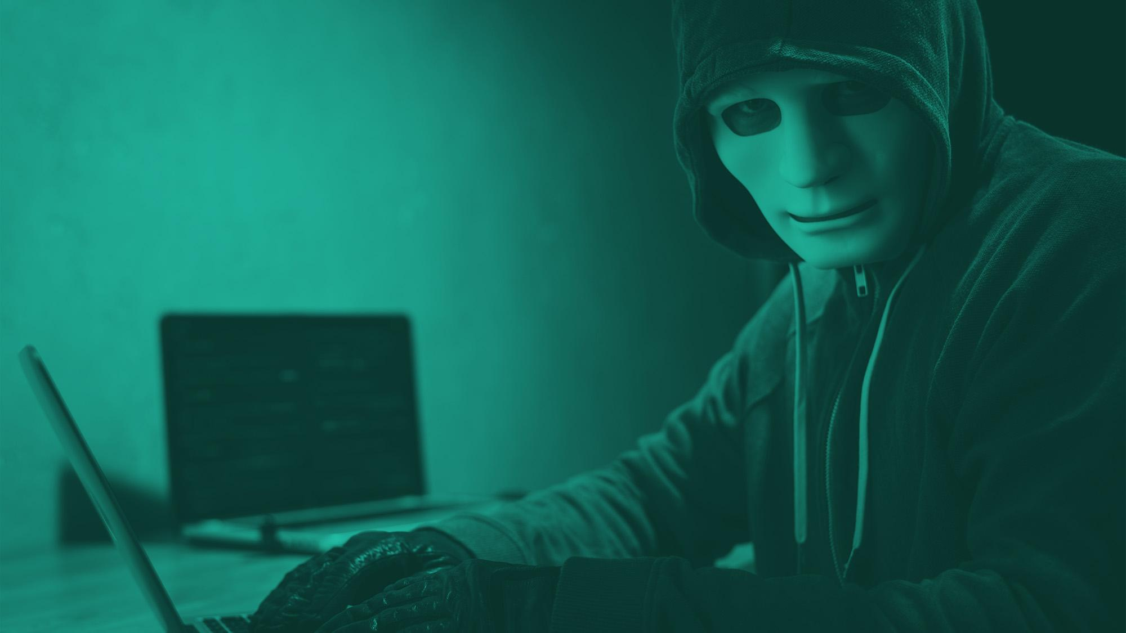
Thank You for Reading!
Stay Safe Online!

